Slide 1


Regional Database for the Mediterranean and Black Seas
1st training on Med&BS RDBFIS-II
online 17th - 19th September 2024

Slide 2


MARE/2020/08 - SI2.839444
Development of the Regional Database for the Mediterranean & Black Seas (Med&BS RDBFIS)
This project has financed under the European Maritime and Fisheries Fund (EMFF)
(period: 01/01/2021 – 28/02/2023)
CINEA/EMFAF/2021/3.1.2/03/SC04/SI2.881222
Specific Contract 2021/3.1.2/03/SC04
Hosting, maintenance and further development of the Regional Database for the Mediterranean and Black Seas
(period: 01/04/2023 – 31/03/2025)

Slide 3
RDBFIS: System overview
RDB
GUI
tools
Aggregated
Detailed bio
Surveys
Stomach content
Coding
Spatial info
Species list
EU fleet …
GUI
access & security
RDBQc
RoME
RoMEBS
BioIndex
MEDIASQc
MCDA
AERQc
Fleet analysis

Slide 4
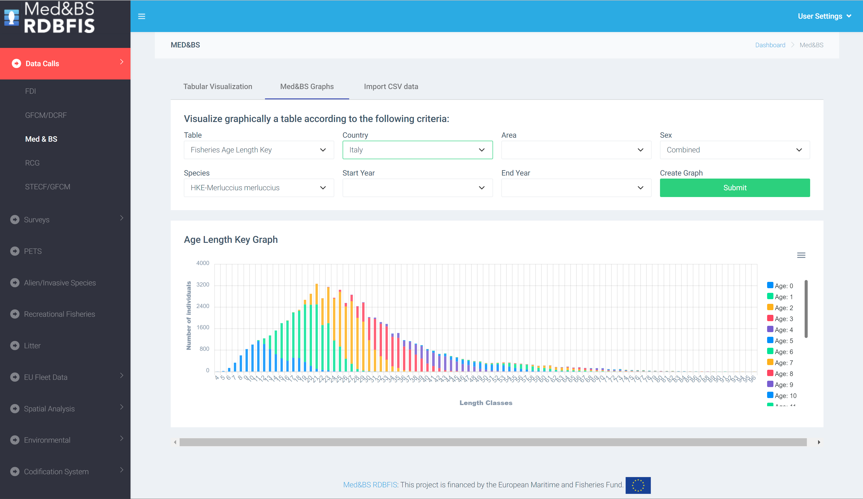
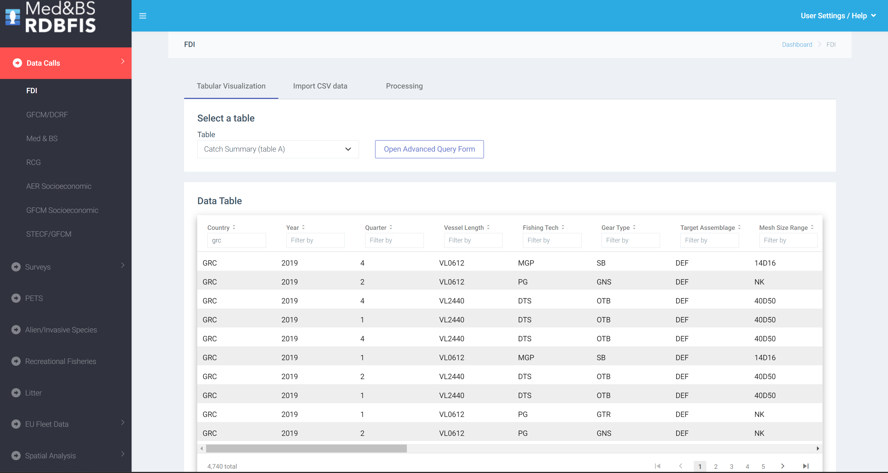
RDBFIS: follow up project
RDBFIS: a web-based integrated fisheries information system for the Med&BS
Centralized database system hosting aggregated DCR/DCF data sets including MEDITS, MEDIAS & BS surveys as well as detailed biological data with a user-friendly interface that make it easier to interact with the system, even if the users do not have deep technical expertise;
Common syntax and consistency procedures ensures the quality of data;
The MS can visualize and manipulate their data;
A “Processing” package support the creation of the datacalls;
Other components are included in the system (spatial effort & landings for SSF, fleet analysis, data entry forms for stomach contents, alien species, …)

Slide 5



RDBFIS: synergies & compatibilities
Updated versions
RDBQc
RoME
RoMEBS
Compatibilities
RCG LP
adopt H10
CL, CE
RDBES

Slide 6
RDBFIS: populate the system with data - steps for uploading data
RDBFIS
Step 1. Syntax check (validation scheme)
.csv
Step 2. Consistency check (quality control routines)
Step 3. Uploading (update RDBFIS)

Slide 7

RDBFIS activities
Fleet Analysis:
an open access dynamic tool to illustrate the evolution of the fleet dynamics in Europe;
populate
the system with data
Stomach contents
Med&BS - ICES structures were adopted
FDI - A space-time tool to estimate spatial effort, weight and value of landings for SSF
FDI - quality checks on FDI spatial data (Table H & Table I)
Maurizio, Maciej, Maksims
Recreational fisheries
PETS
Alien species
RDBFIS & MSFD
Statistical WS
Notes:
A data call was drafted to the relevant Member States of the Med&BS region. The requested datasets covers the periods of the DCR & DCF programs
2002-2022 for Med&BS datacall,
2013-2022 for FDI datacall,
2017-2022 for GFCM/DCRF datacall,
Med&BS RCG data (DCR & DCF: fishing intensity, landings).
Detailed biological data
MEDITS data
AER data
The JRC and GFCM provided the requested datasets;
The Member States are invited to use the RDBFIS to execute syntax and data quality control procedures and store the clean data into the system (through a strict set of validation rules solid based on the datacall ANNEXES). A dedicated RDBFIS team support this process through bilateral contacts and working jointly with the Member States. The process is progressing satisfactorily, the RDBFIS core team supports all MSs’ requirements.

Slide 8
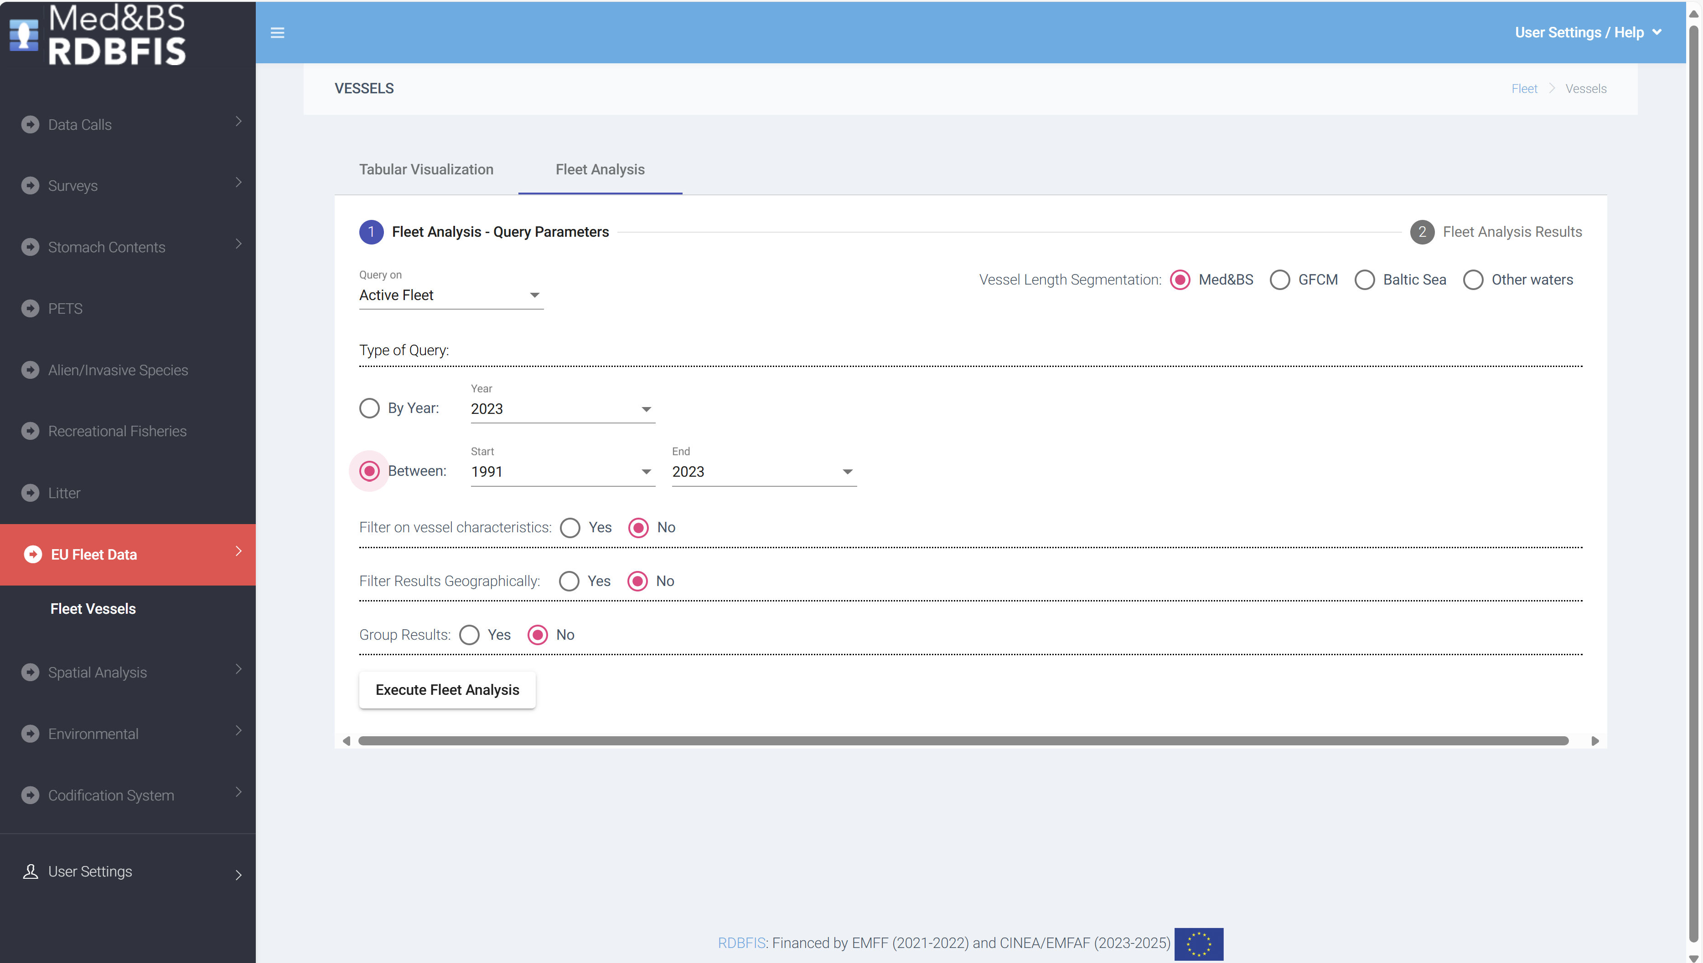
RDBFIS progress work
Fleet analysis: an open access dynamic tool has started to be developed to illustrate the evolution of the fleet dynamics in Europe; possible link with the landings, discards and value (FDI Table A);
Data from the professional fishing fleet, spanning the period from 1991 to 2023, was downloaded from the official EU Fleet Register portal. GIS techniques were employed to spatially join the fishing ports with various geographical entities, including NUTS2 and NUTS3, FDI subregions, Geographical areas (GFCM, ICES). The fishing ports were match to LOCODE from the CIRCAMB Master Data Register. The accuracy of the fishing port locations was validated using information available from the IFREMER Sextant portal. The tool is accessible through the "EU Fleet Data/Fleet Vessels" component of the RDBFIS. Reports can be generated based on user-defined queries about active or decommissioned fishing vessels
Notes:
fleet analysis tool: possible link with the landings/discards – FDI table A

Slide 9

CINEA/EMFAF/2021/3.1.2/03/SC04/SI2.881222
Specific Contract 2021/3.1.2/03/SC04
Hosting, maintenance and further development of the Regional Database for the Mediterranean and Black Seas
We thank you for your attention
https://rdbfis.eu/
Maurizio GIBIN, Maciej ADAMOWICZ, Maksims KOVSARS quality (checks on spatial information and mapping for the FDI EWG)

Slide 10
RDBFIS: MEDIAS integration
1. MEDIAS database structure
Acoustics, Pelagic trawl, CTDs
2. Integration with RDBFIS
3. Validation scheme (acoustics, pelagic trawl)
4. Consistency check (R)
5. Processing (SQL)
Abundance, Biomass, Abundance-Biomass
6. Eggs & Larvae database structure
__________________________________
MEDIAS datacall and doodle for the workshop are running

Slide 11
RDBFIS progress work
AER module has been integrated in the RDBFIS
Perform syntax and consistency checks before submitting data to the JRC. The aim is to decrease discrepancies between the AER and FDI datacalls (cross checking between AER & FDI is a goal for the project)
Calculate specific economic performance indicators for STECF EWG purposes
Clean data for submission
Member States
JRC
Syntax & Consistency
Revised data
Revised data
Clean data
EWGs
Notes:
A data call was drafted to the relevant Member States of the Med&BS region. The requested datasets covers the periods of the DCR & DCF programs
2002-2022 for Med&BS datacall,
2013-2022 for FDI datacall,
2017-2022 for GFCM/DCRF datacall,
Med&BS RCG data (DCR & DCF: fishing intensity, landings).
Detailed biological data
MEDITS data
AER data
The JRC and GFCM provided the requested datasets;
The Member States are invited to use the RDBFIS to execute syntax and data quality control procedures and store the clean data into the system (through a strict set of validation rules solid based on the datacall ANNEXES). A dedicated RDBFIS team support this process through bilateral contacts and working jointly with the Member States. The process is progressing satisfactorily, the RDBFIS core team supports all MSs’ requirements.

Slide 12
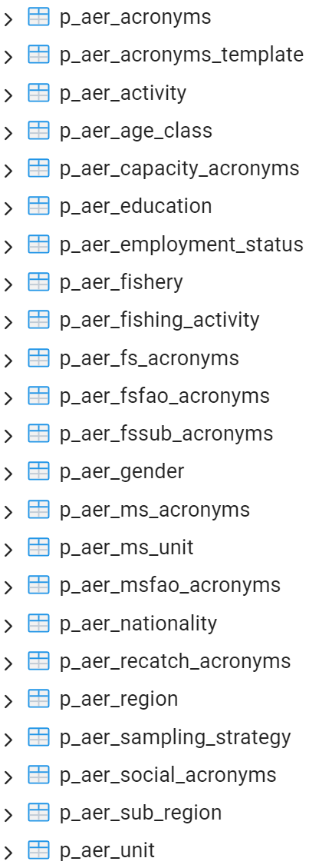
RDBFIS progress work
AER
EU Fishing Fleet Socio-Economic data call
The publicly available data was provided by the JRC
Three variables are missing: achieved_sample_rate, coefficient_of_variation, response_rate
Differences between publicly available data and data hosted on JRC db have been reported
AER database
map_capacity
map_fs
map_fsfao
map_fssub
map_ms
map_msfao
map_recatch
map_social
Validation scheme
Consistency checks (JRC, RCGECON, experts)
Processing routines
AER codification system
gear = NK where no value is available
fishery = NK where no value is available
activity = ?? where null
Notes:
A data call was drafted to the relevant Member States of the Med&BS region. The requested datasets covers the periods of the DCR & DCF programs
2002-2022 for Med&BS datacall,
2013-2022 for FDI datacall,
2017-2022 for GFCM/DCRF datacall,
Med&BS RCG data (DCR & DCF: fishing intensity, landings).
Detailed biological data
MEDITS data
AER data
The JRC and GFCM provided the requested datasets;
The Member States are invited to use the RDBFIS to execute syntax and data quality control procedures and store the clean data into the system (through a strict set of validation rules solid based on the datacall ANNEXES). A dedicated RDBFIS team support this process through bilateral contacts and working jointly with the Member States. The process is progressing satisfactorily, the RDBFIS core team supports all MSs’ requirements.

